Slide 1
Improving Road Awareness with a Real-Time Co-Pilot by Harnessing the Power of Dashcams
Adrian John
CSC 752 - Computer Vision
Supervised by: Dr. Lina Chato
8th November 2024

Slide 2
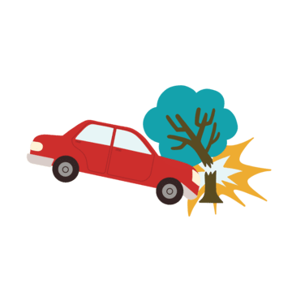
Goal
The primary goal of this project is to improve a driver’s situational awareness at a low cost by providing real-time alerts about nearby traffic signs, crosswalks, and speed limits using
dash-cam footage and machine learning to reduce motor vehicular accidents.

Slide 3
Introduction
Motor vehicle accidents led to ~42,795 fatalities in the U.S. in 2022.
Major causes are speeding and distractions
Auto co-pilot systems have been proven to reduce accidents but are expensive
We want to implement a co-piliot accessible and available for everyone to use

Slide 4
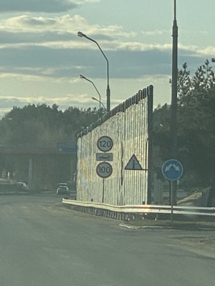
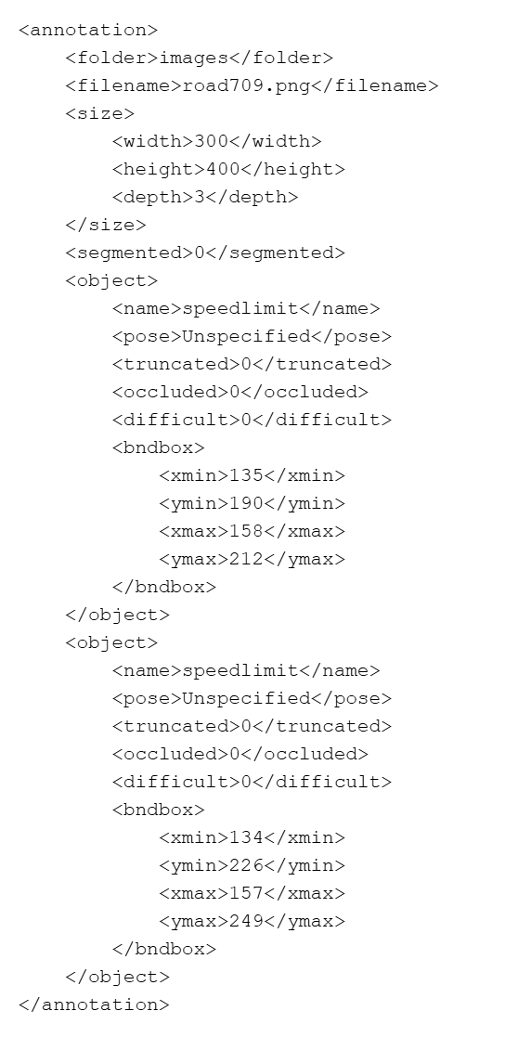
Data
877 png image
Annotations in XML
Extraction
Split 80 / 20
Classes
Stop signs
Speed limit
Traffic lights
Cross walks

Slide 5
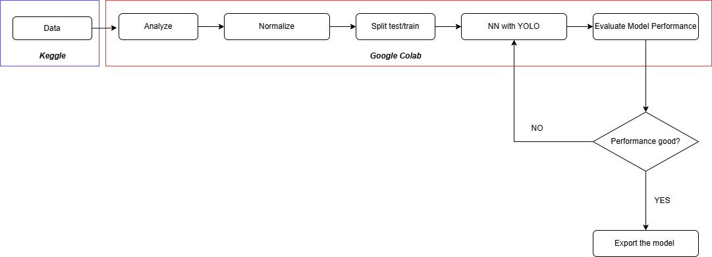
Model
Pre-trained YOLO (You Only Look Once) model, known for real-time object detection.
YOLO v11 can detect over 80 object classes.
Model starts with YOLO11 weights and updates during training
No modifications was made to the architecture of the neural network

Slide 6
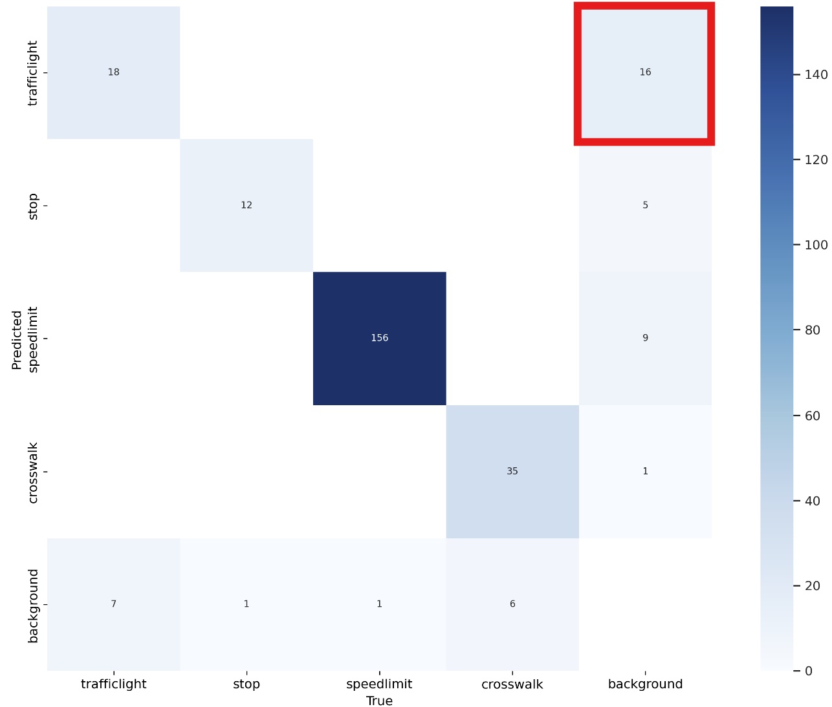
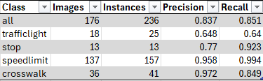
Results
Overall good performance
False Positives for traffic lights

Slide 7
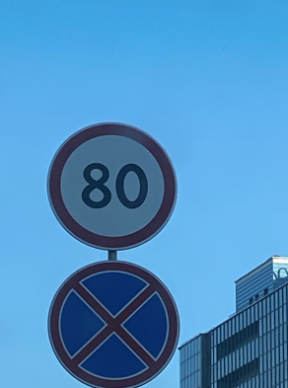
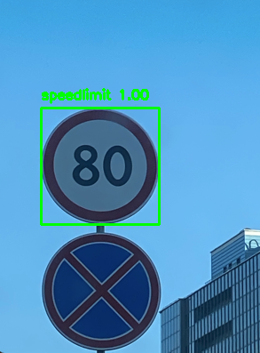
YOLO BASE WEIGHTS
YOLO NEW WEIGHTS

Slide 8
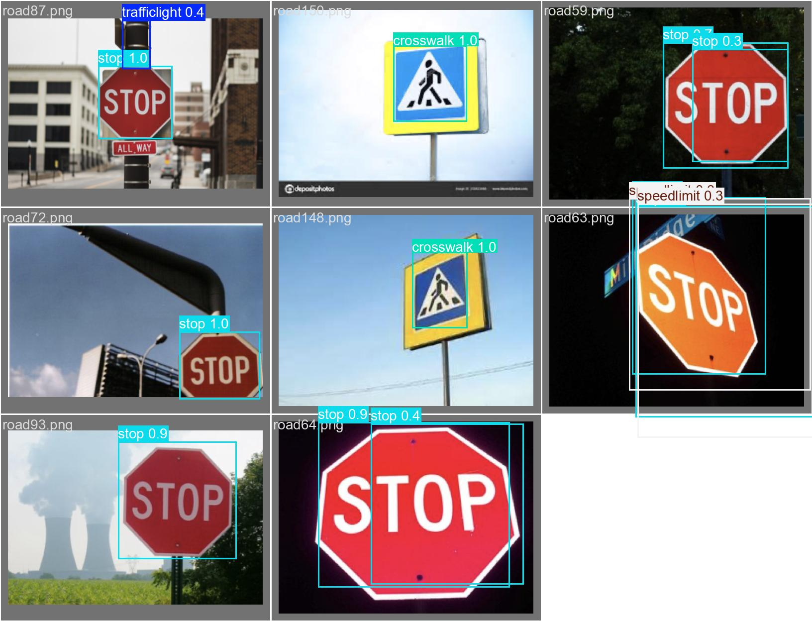

Slide 9

To be completed by week 16
Build a demo to demonstrate the model performing on video data
Improve the performance on the traffic light predictions
More evaluation of the model performance
Implement K-Fold cross validation

Slide 10
FUTURE Direction / CV Enhancements
Capture the vehicle speed and compare it to the actual speed limit
Capture colors from traffic light
Consider other factors like pedestrians
Factor distance between car and objects
Notes:
Explain the diagram

Slide 11
KEY References
Ao, B., Ren, J. and Guo, C. (2019) ‘Impact of image corruptions on the reliability of traffic sign recognition using machine learning technique’, Proceedings of the 2019 3rd International Conference on Compute and Data Analysis, pp. 6–8. doi:10.1145/3314545.3314547.
Kanchana, B. et al. (2021) ‘Computer Vision for autonomous driving’, 2021 3rd International Conference on Advancements in Computing (ICAC) [Preprint]. doi:10.1109/icac54203.2021.9671099.

